Slide 1
Drupal Module
Development

Slide 2


www.zyxware.com
3rd November 2012

Slide 3
An Introduction to
Drupal

Slide 4
What is Drupal
Content management framework
Pluggable architechute
Free Software
Large community

Slide 5
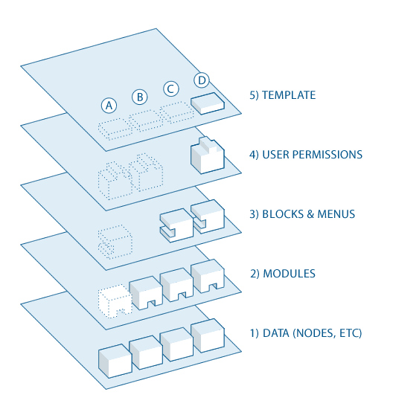
Drupal Data Flow

Slide 6
General Concepts
Fields
Node/Entities
Comments
Module
Region, Block, Menu
User, Permission, Role
Theme
Views
Taxonomy
Database
Path

Slide 7
Content Types in Drupal
Article
Page
Custom Content types

Slide 8
Bootstrapping Drupal
Walk through the code
Walk through the database

Slide 9
Developing a module for Drupal
Hook System

Slide 10
Start Coding
Info file
name = Current Posts
description = A block module that lists links to recent posts.
core = 7.x

Slide 11
hook_help
/**
* Implements hook_help.
*
* Displays help and module information.
*
* @param path
* Which path of the site we're using to display help
* @param arg
* Array that holds the current path as returned from arg() function
*/
function current_posts_help($path, $arg) {
switch ($path) {
case "admin/help#current_posts":
return '<p>' . t("Displays links to nodes created on this date") . '</p>';
break;
}

Slide 12
Declaring the block
/**
* Implements hook_block_info().
*/
function current_posts_block_info() {
$blocks['current_posts'] = array(
'info' => t('Current posts'), //The name that will appear in the block list.
'cache' => DRUPAL_CACHE_PER_ROLE, //Default
);
return $blocks;
}

Slide 13
Retrieving Data
/**
* Custom content function.
*
* Set beginning and end dates, retrieve posts from database
* saved in that time period.
*
* @return
* A result set of the targeted posts.
*/
function current_posts_contents(){
//Get today's date.
$today = getdate();
//Calculate the date a week ago.
$start_time = mktime(0, 0, 0,$today['mon'],($today['mday'] - 7), $today['year']);
//Get all posts from one week ago to the present.
$end_time = time();
//Use Database API to retrieve current posts.
$query = db_select('node', 'n')
->fields('n', array('nid', 'title', 'created'))
->condition('status', 1) //Published.
->condition('created', array($start_time, $end_time), 'BETWEEN')
->orderBy('created', 'DESC') //Most recent first.
->execute();
return $query;
}

Slide 14
Generating block content
/**
* Implements hook_block_view().
*
* Prepares the contents of the block.
*/
function current_posts_block_view($delta = '') {
switch($delta){
case 'current_posts':
$block['subject'] = t('Current posts');
if(user_access('access content')){
//Use our custom function to retrieve data.
$result = current_posts_contents();
//Array to contain items for the block to render.
$items = array();
//Iterate over the resultset and format as links.
foreach ($result as $node){
$items[] = array(
'data' => l($node->title, 'node/' . $node->nid),
);
}
if (empty($items)) { //No content in the last week.
$block['content'] = t('No posts available.');
}
else {
//Pass data through theme function.
$block['content'] = theme('item_list', array(
'items' => $items));
}
}
return $block;
}
}

Slide 15
Module Configuration Form - 1
/**
* Implements hook_menu().
*/
function current_posts_menu() {
$items = array();
$items['admin/config/content/current_posts'] = array(
'title' => 'Current posts',
'description' => 'Configuration for Current posts module',
'page callback' => 'drupal_get_form',
'page arguments' => array('current_posts_form'),
'access arguments' => array('access administration pages'),
'type' => MENU_NORMAL_ITEM,
);
return $items;
}

Slide 16
Module Configuration Form - 2
/**
* Page callback: Current posts settings
*
* @see current_posts_menu()
*/
function current_posts_form($form, &$form_state) {
$form['current_posts_max'] = array(
'#type' => 'textfield',
'#title' => t('Maximum number of posts'),
'#default_value' => variable_get('current_posts_max', 3),
'#size' => 2,
'#maxlength' => 2,
'#description' => t('The maximum number of links to display in the block.'),
'#required' => TRUE,
);
return system_settings_form($form);
}

Slide 17
Editing Query
function current_posts_contents() {
//Get today's date.
$today = getdate();
//Calculate midnight a week ago.
$start_time = mktime(0, 0, 0,$today['mon'],($today['mday'] - 7), $today['year']);
//Get all posts from one week ago to the present.
$end_time = time();
//NEW LINE
$max_num = variable_get('current_posts_max', 3);
//Use Database API to retrieve current posts.
$query = db_select('node', 'n')
->fields('n', array('nid', 'title', 'created'))
->condition('status', 1) //Published.
->condition('created', array($start_time, $end_time), 'BETWEEN')
->orderBy('created', 'DESC') //Most recent first.
->range(0, $max_num) //NEW LINE
->execute();
return $query;
}

Slide 18
Add configuration to info file
name = Current Posts
description = A block module that lists links to recent posts.
core = 7.x
; NEW LINE
configure = admin/config/content/current_posts

Slide 19
Validating data
/**
* Implements validation from the Form API.
*
* @param $form
* A structured array containing the elements and properties of the form.
* @param $form_state
* An array that stores information about the form's current state
* during processing.
*/
function current_posts_form_validate($form, &$form_state){
$max_num = $form_state['values']['current_posts_max'];
if (!is_numeric($max_num)){
form_set_error('current_posts_max', t('You must enter a number for the maximum number of posts to display.'));
}
else if ($max_num <= 0){
form_set_error('current_posts_max', t('Maximum number of posts to display must be positive.'));
}
}

Slide 20
Permissions for a new page
/**
* Implements hook_permission().
*/
function current_posts_permission() {
return array(
'access current_posts content' => array(
'title' => t('Access content for the Current posts module'),
)
);
}

Slide 21
To hook_menu
$items['current_posts'] = array(
'title' => 'Current posts',
'page callback' => '_current_posts_page',
'access arguments' => array('access current_posts content'),
'type' => MENU_NORMAL_ITEM, //Will appear in Navigation menu.
);

Slide 22
To current_posts_page
/**
* Custom page callback function, declared in current_posts_menu().
*/
function _current_posts_page() {
$result = current_posts_contents('page');
//Array to contain items for the page to render.
$items = array();
//Iterate over the resultset and format as links.
foreach ($result as $node) {
$items[] = array(
'data' => l($node->title, 'node/' . $node->nid),
);
}
if (empty($items)) { //No content in the last week.
$page_array['current_posts_arguments'] = array(
//Title serves as page subtitle
'#title' => t('All posts from the last week'),
'#markup' => t('No posts available.'),
);
return $page_array;
}
else {
$page_array['current_posts_arguments'] = array(
'#title' => t('All posts from the last week'),
'#items' => $items,
//Theme hook with suggestion.
'#theme' => 'item_list__current_posts',
);
return $page_array;
}
}

Slide 23
Modify the query
function current_posts_contents($display){ //$display argument is new.
//Get today's date.
$today = getdate();
//Calculate midnight a week ago.
$start_time = mktime(0, 0, 0,$today['mon'],($today['mday'] - 7), $today['year']);
//Get all posts from one week ago to the present.
$end_time = time();
$max_num = variable_get('current_posts_max', 3);
//Use Database API to retrieve current posts.
$query = db_select('node', 'n')
->fields('n', array('nid', 'title', 'created'))
->condition('status', 1) //Published.
->condition('created', array($start_time, $end_time), 'BETWEEN')
->orderBy('created', 'DESC'); //Most recent first. Query paused here.
if ($display == 'block'){
// Restrict the range if called with 'block' argument.
$query->range(0, $max_num);
} //Now proceeds to execute().
//If called by page, query proceeds directly to execute().
return $query->execute();
}

Slide 24
Modify view block
$result = current_posts_contents('block');

Slide 25
Thank You!
Vimal Joseph vimal.joseph@zyxware.com

Slide 26

Zyxware Technologies
3/2457(6), TKD Road, Marappalam
Pattom P. O., Trivandrum, Kerala - 695004, India
Tel: 0471-4063818(O), +91-9446-06-9446 (M) info@zyxware.com

